Slide 1

KINEMATICS 2D
FISIKA DASAR 1

Slide 2
Projectile Motion
Circular Motion
Dimensional Analysis
Overview
Adopted from MIT Course

Slide 3
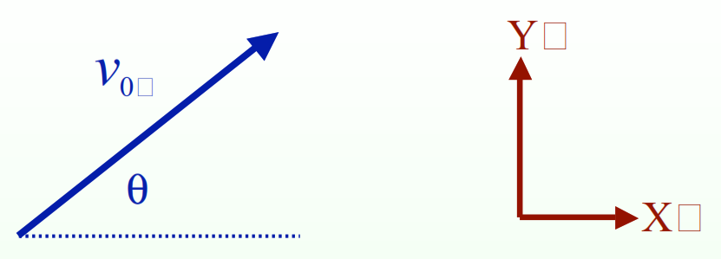

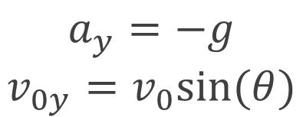
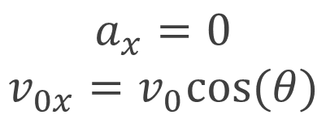
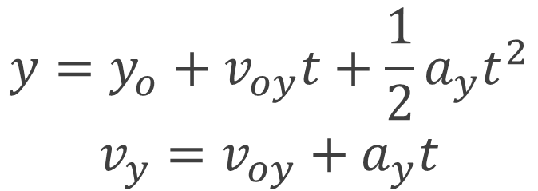
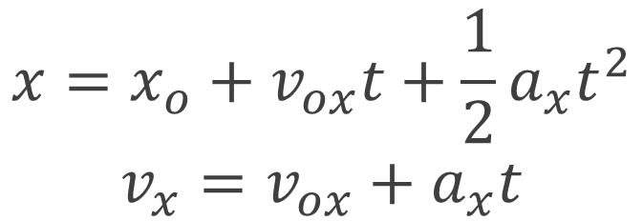
Projectile Motion
Kinematics
$$x=x_{o}+v_{ox}t+\frac{1}{2}a_{x}t^{2}$$
$$v_{x}=v_{ox}+a_{x}t$$
$$y=y_{o}+v_{oy}t+\frac{1}{2}a_{y}t^{2}$$
$$v_{y}=v_{oy}+a_{y}t$$
$$a_{x}=0$$
$$v_{0x}=v_{0}cos⁡(θ)$$
$$a_{y}=−g$$
$$v_{0y}=v_{0}sin⁡(θ)$$
Adopted from MIT Course

Slide 4
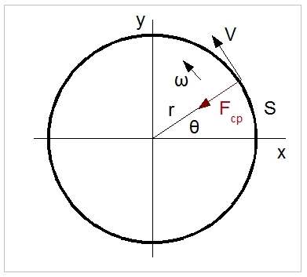
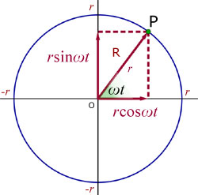
Circular Motion

Slide 5
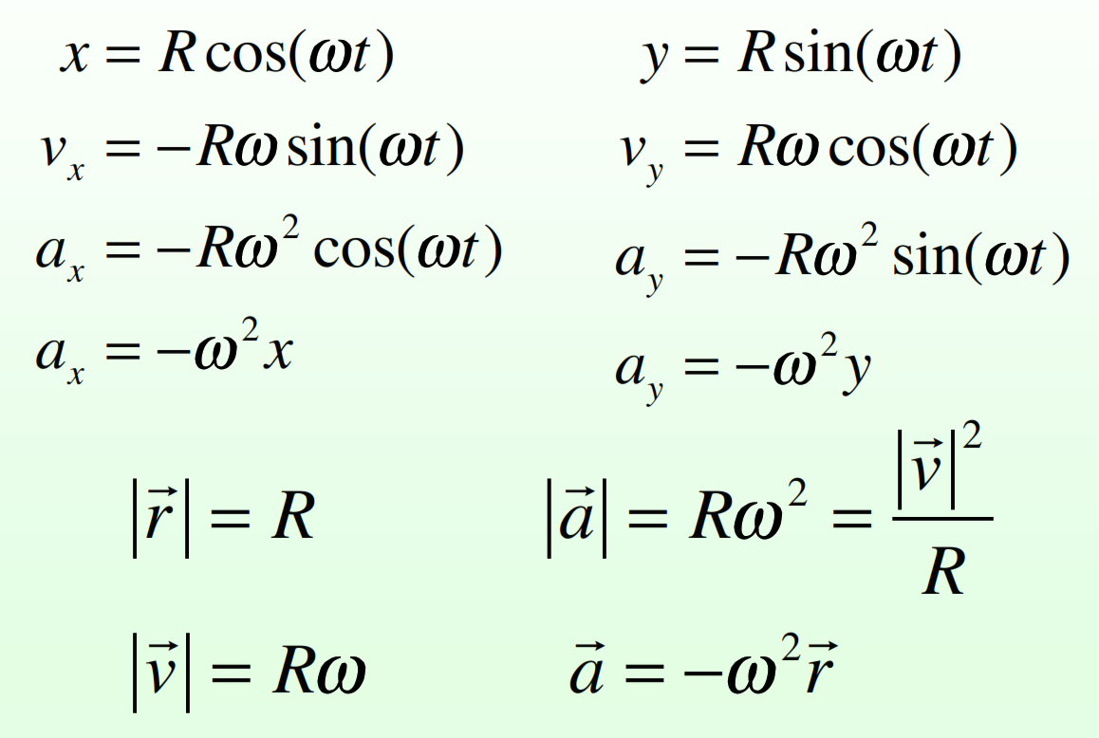
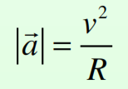
Circular Motion Equations
Circular Motion Summary
Kinematics
Trajectories with gravity near the surface of the Earth and no air resistance or other drag forces.
The velocity is constant in magnitude but changes direction. It points tangentially.
The acceleration is constant in magnitude but changes direction. It points radially inward.
The magnitude of the acceleration is given by:
Adopted from MIT Course

Slide 6
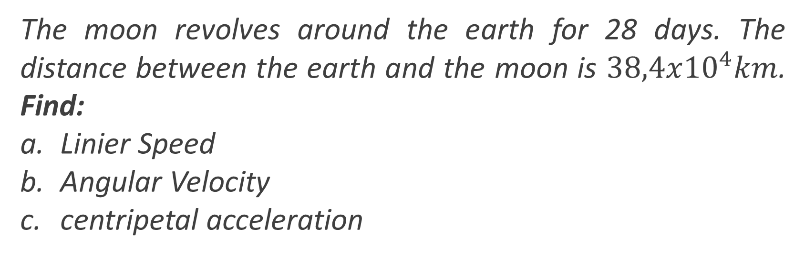
Example 1
Example
The moon revolves around the earth for 28 days. The distance between the earth and the moon is $38,4x{10}^{4}km$. Find:
Linier Speed
Angular Velocity
centripetal acceleration

Slide 7
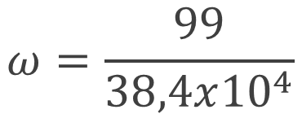



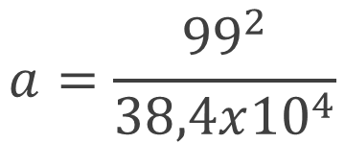

Example
Solution:
a.
$s=2πR=2π$ $38,4x{10}^{4}=24,13x{10}^{8}m$
$$t=28x24x3600=24,19x{10}^{5}s$$
$$v=24,13x{10}^{8}x 24,19x{10}^{5}=99m/s$$
b.
$$ω=v/R$$
c.
$$a=v^{2}/R$$
$$ω=\frac{99}{38,4x{10}^{4}}$$
$$a=\frac{{99}^{2}}{38,4x{10}^{4}}$$
$$=3,58x{10}^{−7}rad/s$$
$$=26x{10}^{−6}m/s^{2}$$

Slide 8
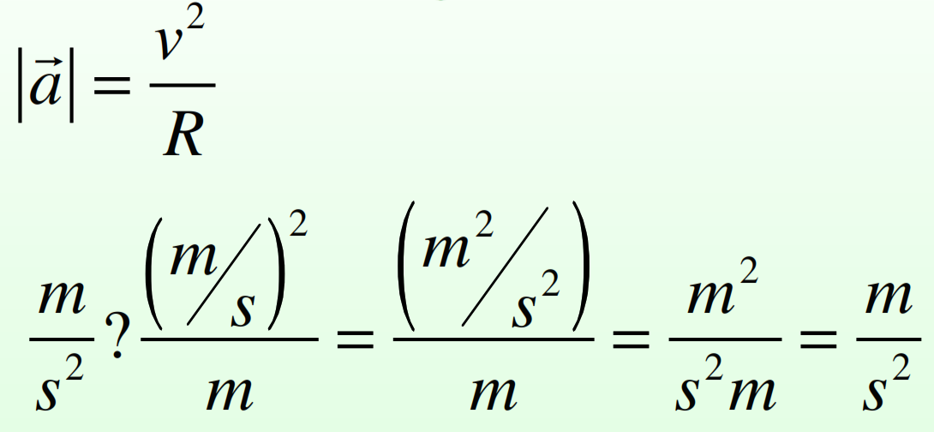
Dimensional Analysis
Kinematics 2D
Name for a technique of checking the dimensions (or units) of an answer to check for careless mistakes in the formulas or algebra.
Example:
Adopted from MIT Course

Slide 9
SUMMARY
Position, velocity, and acceleration are ALL vectors and need to be manipulated using either arrows (qualitative) or components (quantitative)
A vector can change by changing its magnitude (speed) or direction or both. All three changes imply the presence of an acceleration
Checking the units or dimensions of an answer will help to guard against simple careless mistakes
Adopted from MIT Course

Slide 10
THANK YOU

